Slide 1


Slide 2


Industry-Based Projects
PROJECT TITLE :-
Smart CarbonTrack
Digital Monitoring and Reduction of carbon footprint for Manufacturing unit
A Sustainability Monitoring Tool for Manufacturing Units
TEAM : 26E2022 - J_Coders

Slide 3
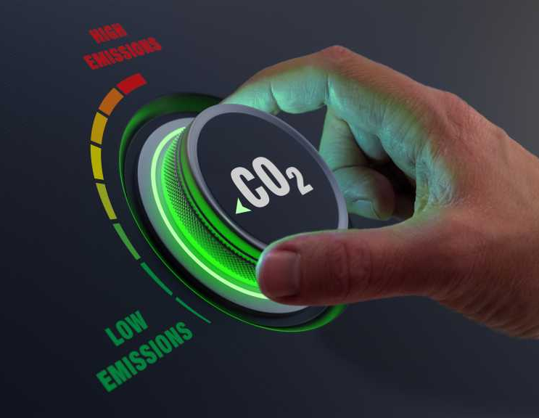
Problem Statement
Manufacturing industries consume large amounts of energy
Carbon emissions are often not tracked monthly
Manual calculations are:
- Time-consuming
- Error-prone
Difficulty in understanding:
- Energy efficiency
- Carbon intensity
- Renewable energy usage
Industries lack a simple, structured system to monitor carbon footprint regularly and make data-driven sustainability decisions.

Slide 4

Project Objective
To digitally monitor monthly carbon footprint
To calculate energy and carbon KPIs automatically
To help industries track:
  Renewable energy share
  Green fuel usage
To support sustainability and compliance goals
The aim is not just data entry, but meaningful analysis using KPIs.

Slide 5
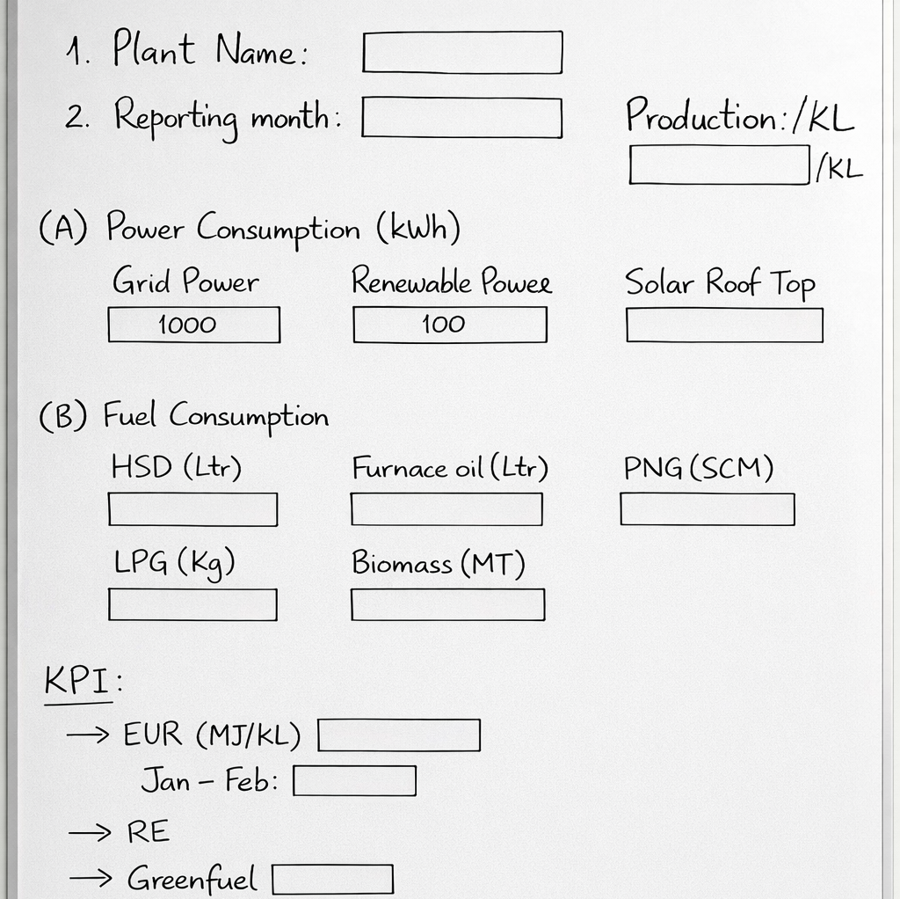
Monthly Input Data
Inputs entered by plant:
Electricity consumption (kWh)
Fuel consumption (Diesel / Coal / Gas)
Production quantity (Units / Tons)
Data Entries
done by plant
These are basic values that industries already have, so no extra sensors are required

Slide 6
Automatically Calculated KPIs
KPIs calculated:
Total energy consumption
Carbon emissions (CO₂ equivalent)
Carbon intensity
(Emissions per unit of production)
Renewable energy share (%)
Green fuel percentage (%)
The system converts raw data into useful performance indicators automatically

Slide 7
Working of Smart CarbonTrack
Monthly Data Input
Emission Factors Applied
Energy & Carbon Calculations
KPIs Generated
Sustainability Insights
Flow of
Smart CarbonTrack

